Slide 1
Robot Arm Project Cost Finding
OHT Mark 2 PM Workflow Simulator Date: July 2026

Slide 2
Project Objective
Current State: The PM sensor connection is manual, labour-intensive, and prone to human error. Proposed Solution: Integrate a Collaborative Robot (Cobot) arm to automatically handle the sensor plug connection to the OHT. Goal: Reduce operational downtime, eliminate manual alignment errors, and enable a fully automated, vision-assisted PM workflow.

Slide 3
Vendor Comparison
Criteria | OMRON (TM5S) | Universal Robots (UR7e) | ABB | ABB
Price Range | SGD 100k - 150k | ~SGD 29k - 36k | ~SGD 30k (GoFa13) ~SGD 20k (GoFa5) | ~SGD 20K (PoWa13) ~SGD 15K (PoWa7)
Reach | 900 mm | ~730mm - 1300mm | Up to 1300mm Up to 950mm | Up to 1300mm Up to 900mm
Speed | 1.4 m/s | Up to 1.0 m/s | Up to 2.2 m/s | Up to 5.8m/s
Safety | Advanced collision | 17 configurable functions | Advanced torque sensors – all 6 axis | SafeMove (current monitoring)
Vision | Built-in / Integrated | Third Party | Third Party ~SGD 5k (SICK Smart Vision) | Third Party Supports plug-and-play flange integration
Additional Add-ons | 2x Landmark (~SGD 20) to increase vision accuracy, readjust all OHT port position to the same. | Retrofit 4 Port into Magnetic Plug, vision to help match and position flange to plug into position | Retrofit 4 Port into Magnetic Plug, vision to help match and position flange to plug into position | Retrofit 4 Port into Magnetic Plug, have to depend on position deviation to its minimal.

Slide 4
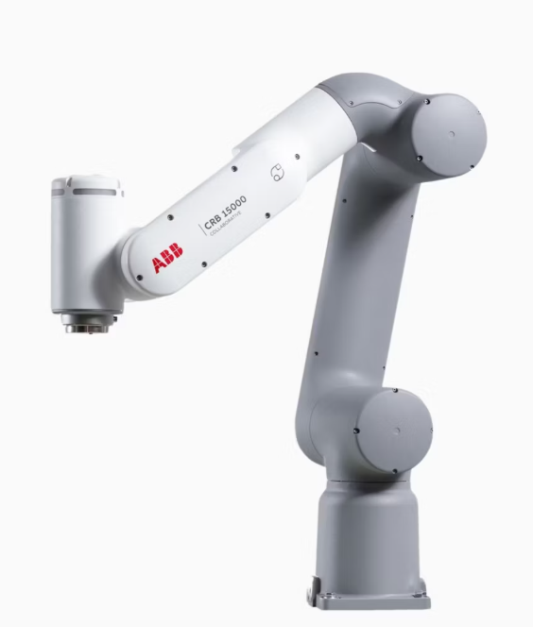
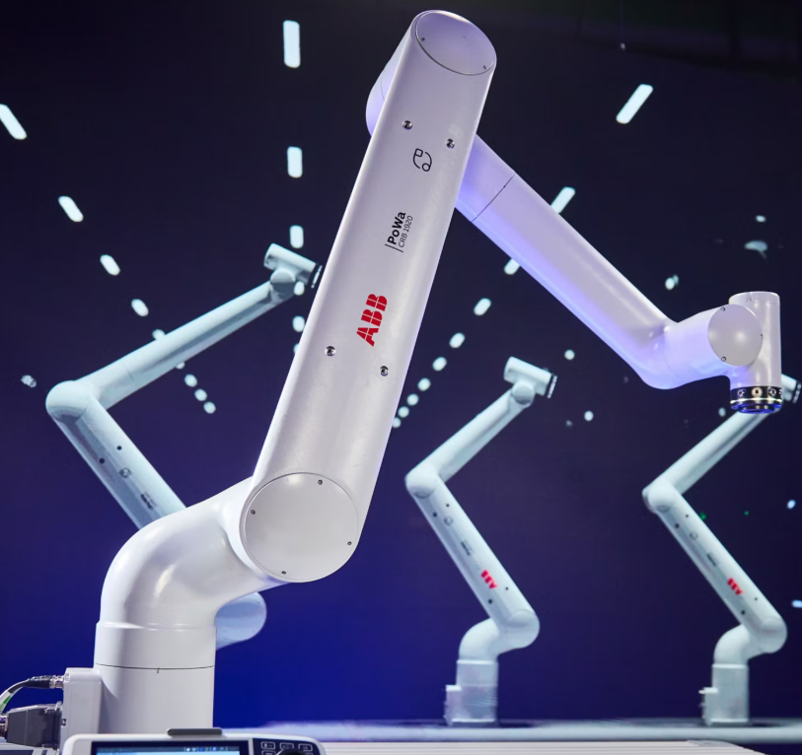
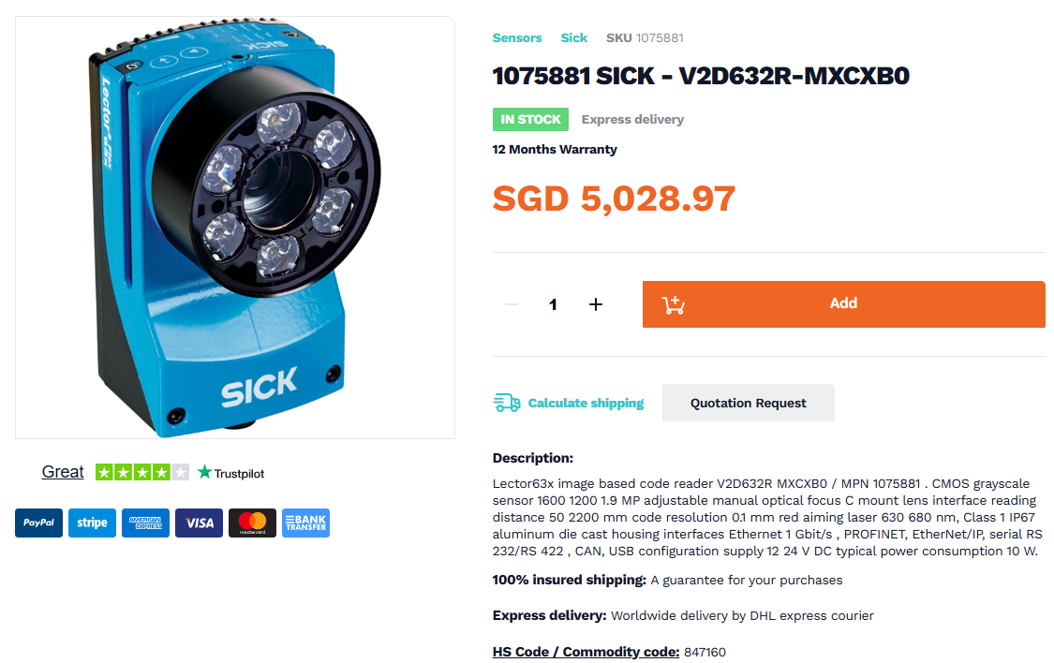
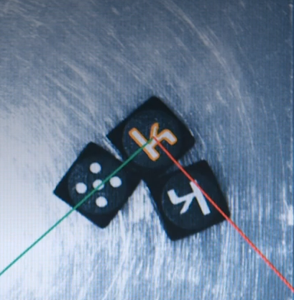
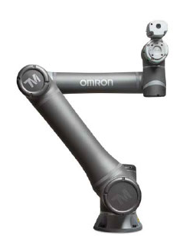
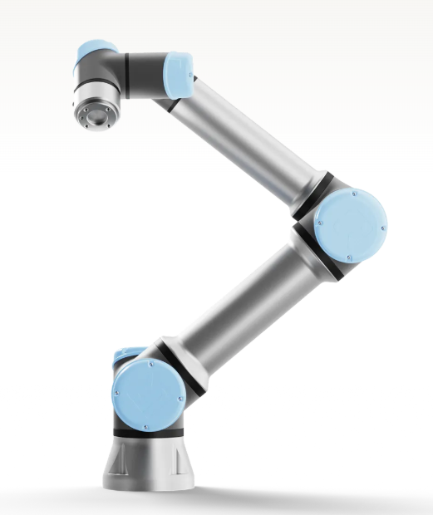
ABB GoFa
ABB PoWa
Video Demo
PLOC2D-631C - PLOC2D | SICK
Omron TM series
UR7e

Slide 5
Retrofit Cost Analysis (304 Vehicles)
Component / Requirement | Est. Unit Cost | Total Cost
Magnetic 15-Pin Plug (Premium Rosenberger) from RS | SGD 70 | SGD 21,280
Magnetic 15-Pin Plug (Cheaper OEM Alternative) | ~SGD 15 | ~SGD 4,560
Custom PCB Breakout & Relays | ~SGD 8 | ~SGD 2,432
GRAND TOTAL (Premium Plug) | - | ~SGD 23,712
GRAND TOTAL (Cheaper OEM Plug) | - | ~SGD 6,992

Slide 6
Magnetic Sourcing & PCB Implementation
Manufacturer / Brand | Connector Quality | Est. Unit Price
MultiMag 15, Straight Panel 15 way Magnetic Connector, Brass Contact, PCB | Rosenberger from RS | ~SGD 70.00
[CXA-0241] 12 pin magnetic charging cable connector | CFE Electronic Co.,Ltd | ~To be enquired
[CFA-0241] 12 Pin magnetic charging cable connector | CLE TECH CO.,LTD | ~To be enquired
12V 3A Magnetic Pogo Pin Connector 8P-12P Male Female Socket | Standard Pogo-Pin | ~SGD 4.00
The Bridge Board: We will design a tiny, custom PCB (~SGD 3 each) to seamlessly map the magnetic pins to our standard wires.

Slide 7
